Slide 1
Advanced Microelectronics Lab
amr.alaa@guc.edu.eg
C3.305 (Back office)
Sandy.abdelmalak@guc.edu.eg
C3.207

Slide 2
Grading Scheme
• Digital part:
• Each task is graded out of 100:
Task Bonus: Weekly for the first student to submit within the session or for creative work

Slide 3
Rules
Groups of Three
Evaluation
Mini-Task
Oral discussion
Food and drinks are not allowed inside the lab
Cross attendance is not allowed

Slide 4
VGA
VGA: Video Graphics Array
CRT-based VGA uses amplitude modulating moving electron beams to display information on a phosphor coated screen.
LCD-based VGA use an array of switches that can impose a voltage across a small amount of liquid crystals thereby changing light permittivity through the crystal on a pixel-by-pixel basis.

Slide 5
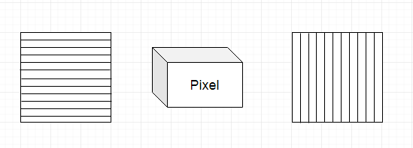
LCD
An LCD screen has a bright light at the back blocked by millions of pixels. Each pixel is made of sub-pixels that are green, red and blue. Each pixel has a polarizing glass filter behind it and in front of it, these filters are at an angle of 90˚. This means that normally no light will pass through resulting in a black screen.
Liquid
Crystal

Slide 6
LCD
In between the two polarizing filters there's a tiny twisted, nematic liquid crystal that can be switched on or off (twisted or untwisted) electronically. When it's switched off, it rotates the light passing through it through 90 degrees, effectively allowing light to flow through the two polarizing filters and making the pixel look bright. When it's switched on, it doesn't rotate the light, which is blocked by one of the polarizers, and the pixel looks dark. Each pixel is controlled by a separate transistor (a tiny electronic component) that can switch it on or off many times each second.
Liquid Crystal has properties of liquids as well as the sloid crystals. It may flow like a liquid, however the molecules are oriented as a solid crystal structure.

Slide 7
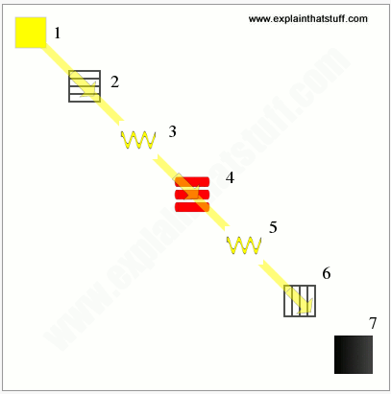
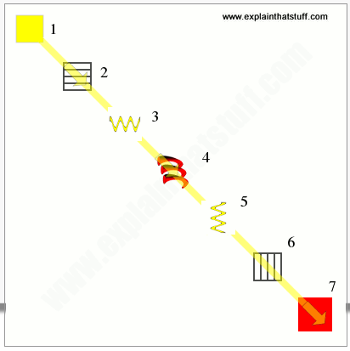
LCD
Each pixel is controlled by a transistor
Pixels are ON
Pixels are OFF

Slide 8
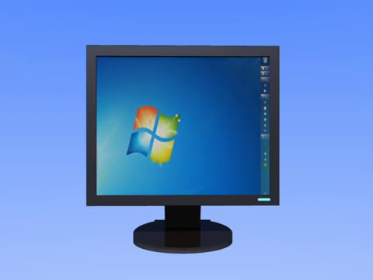
LCD

Slide 9
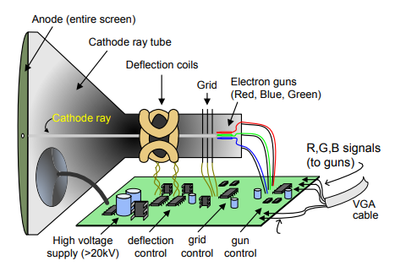
CRT
Color CRT displays use three electron beams (one for red, one for blue, and one for green) to energize the phosphor that coats the inner side of the display end of a cathode ray tube ➔ Requires refreshing

Slide 10
CRT
The cathode ray follows a raster pattern, horizontally from left to right and vertically from top to bottom. As the cathode ray moves over the surface of the display, the current sent to the electron guns can be increased or decreased to change the brightness of the display at the cathode ray impact point.
Information is only displayed when the beam is moving in the "forward" direction (left to right and top to bottom), and not during the time the beam is reset back to the left or top edge of the display. Much of the potential display time is therefore lost in "blanking" periods when the beam is reset and stabilized to begin a new horizontal or vertical display pass.

Slide 11
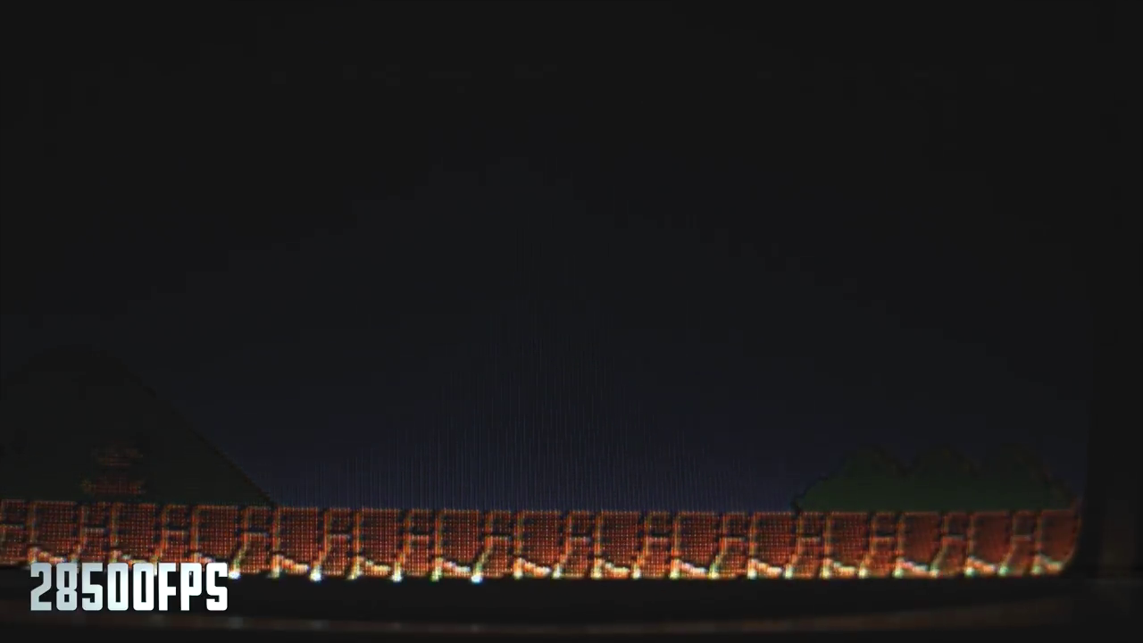
VGA Timing

Slide 12
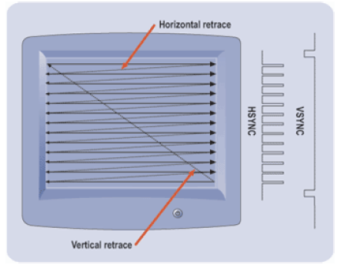
VGA Timing
Resolution: 640x480 pixels
VGA Signals: R, G, B, Hsync and Vsync.
One Hsync per scan line
One Vsync per frame

Slide 13
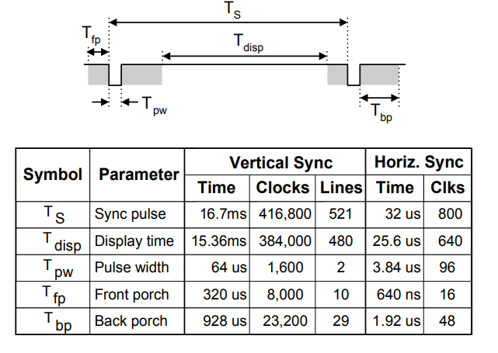
VGA Timing
VGA Timing for a 25MHz clock

Slide 14
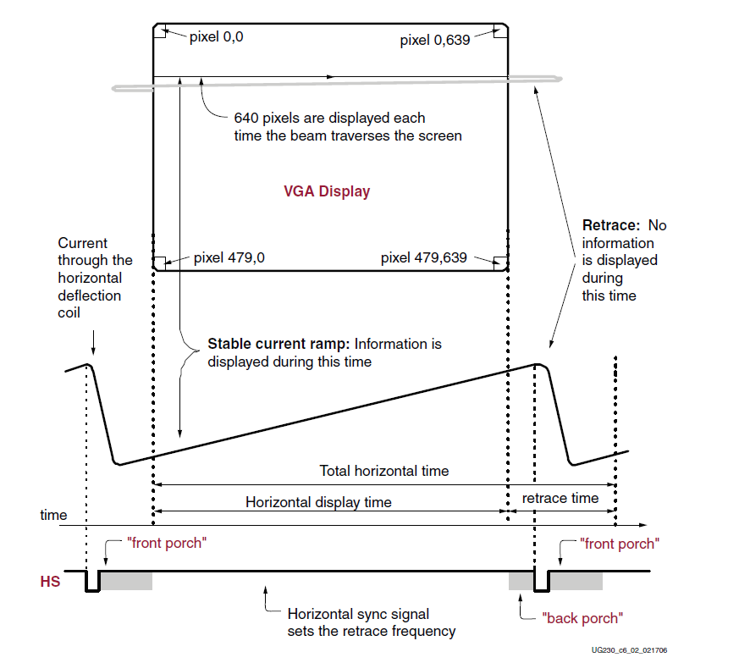
VGA Timing

Slide 15
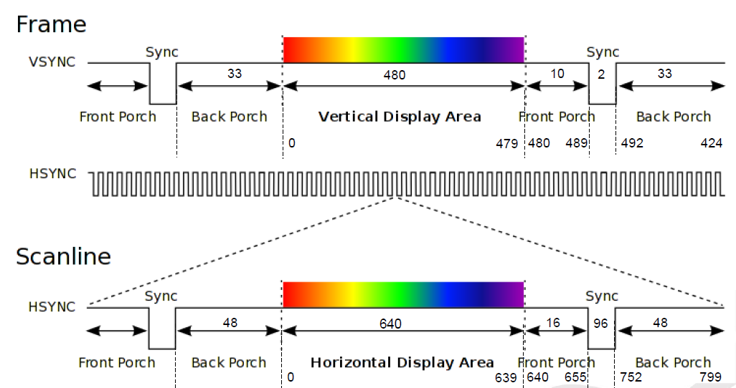
VGA Timing

Slide 16
Colors
Color | RGB
Black | 000
Blue | 001
Green | 010
Cyan | 011
Red | 100
Purple | 101
Yellow | 110
White | 111
Link for color palette for 12 bits RGB:
https://rangevoting.org/ColorCode.html

Slide 17
Task
Task 1
Program the FPGA board using VHDL such that it controls a CRT/LCD screen for which you are required to change the screen color based on the user selection through 3 switches inputs (8 color combinations)
Task 2
Program the FPGA board using VHDL to display a fixed image on the screen. Use MATLAB to convert the image into RGB values in binary form.

Slide 18
Thank You
If you have any questions please contact me through email or join the office hours
amr.alaa@guc.edu.eg
Do not hesitate to send me any feedback regarding the tutorials

